Slide 1


Price Prediction
August / 16 / 2020
BTC Case Study
By Saud Ishaq

Slide 2
Agenda
Objective
Data
Final Model
Opportunities
Introduction
Visualization

Slide 3

Why Bitcoin?
Fintech
New Markets
Future

Slide 4

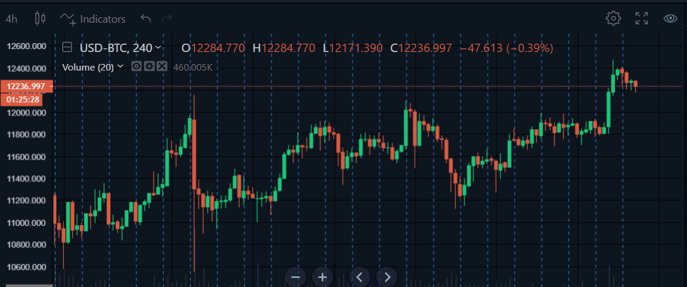
Overview
Satoshi Nakamoto
2008
“Bitcoin is money”

Slide 5

Objective
Prediction
Analysis
Knowledge
Decision

Slide 6
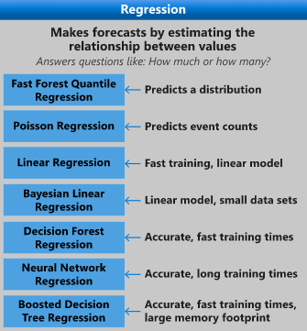
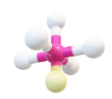


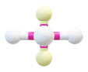



Data
API
Keras
LTSM
Adam
Power BI

Slide 7
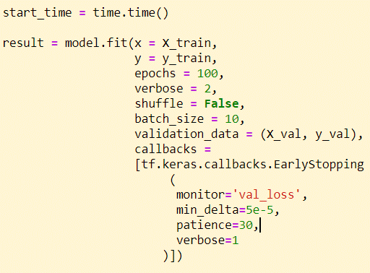
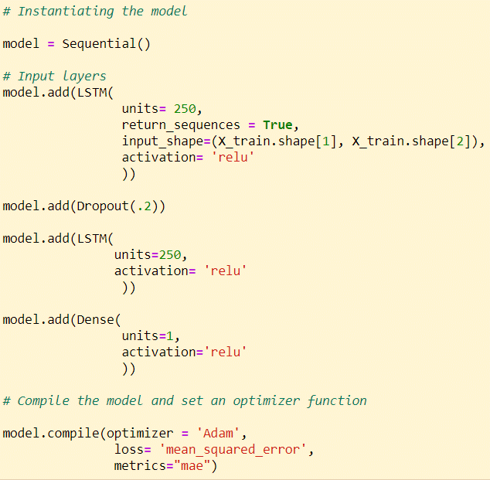
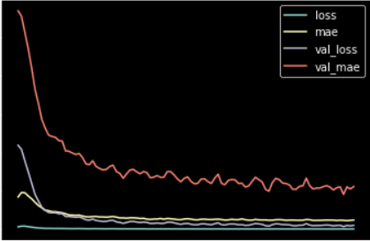
Data

Slide 8
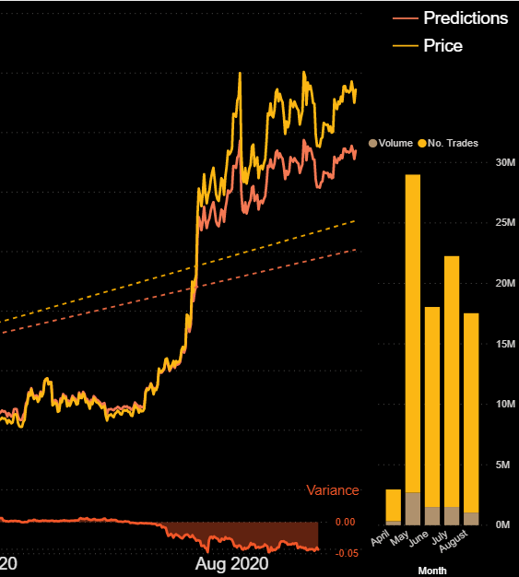
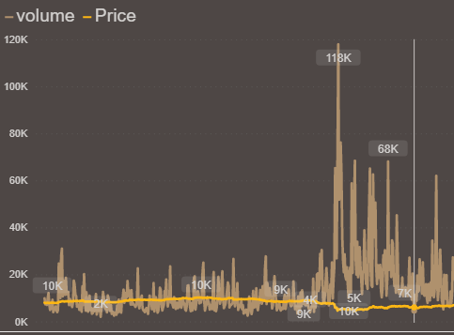
Dashboard

Slide 9

Plans
Part 1:
Sentiment Analysis
Correlated indexes
Explore Deep Learning
Fintech Research Paper
Part 2:
Trading Bot

Slide 10


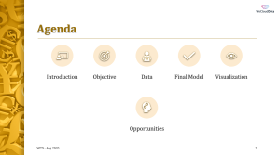
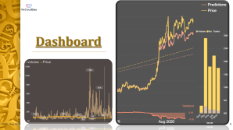
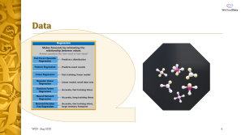

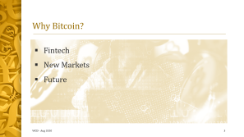
Questions
Saud Ishaq

